Slide 1


Identity as a Service (IDaaS)
Modern Cloud-Native Identity Management for Engineering Teams
September 24, 2025

Slide 2
Agenda
Introduction to IDaaS Overview of OIDC (OpenID Connect) Overview of LDAP Integrating OIDC and LDAP Reference Architecture for IDaaS Login and Access Flow Practical Implementation Guidance CI/CD Pipeline and Deployment Tenant Isolation Strategies Security and Observability Summary and Conclusion

Slide 3


Introduction to IDaaS
Introduction
Include examples of how your team's current projects could benefit from centralized identity management to make the content relatable.
IDaaS provides scalable, cloud-based identity and access management as a service. It supports authentication, authorization, and user lifecycle management across diverse applications and platforms. Modern engineering teams rely on IDaaS to unify identity across cloud, mobile, and on-premises systems. IDaaS enhances security by centralizing identity controls, enabling MFA, and supporting zero trust architectures. It reduces operational complexity by offloading identity infrastructure and enabling rapid integration with modern and legacy apps.

Slide 4
What is OIDC?
OIDC
Tailor the examples of modern apps using OIDC to your organization's technology stack for better audience engagement.
01
02
03
OpenID Connect (OIDC) Defined
Role in Modern Applications
Key Benefits of OIDC
OIDC is a simple identity layer built on top of the OAuth2 authorization framework. It provides a standard way to authenticate users and obtain profile information through JSON Web Tokens (JWTs).
OIDC is the preferred authentication protocol for SaaS applications, APIs, and modern mobile or single-page applications (SPAs), supporting Single Sign-On (SSO) and delegated authorization.
It enables secure user authentication with minimal friction, supports scopes for fine-grained access control, issues interoperable JWT tokens, and simplifies integration across diverse web and mobile platforms.

Slide 5
What is LDAP?
LDAP
01
Legacy Directory Protocol
LDAP (Lightweight Directory Access Protocol) is a mature, widely used protocol for accessing and maintaining distributed directory information services, especially in legacy and enterprise environments.
Customize this slide by adding examples of legacy applications or network equipment specific to your organization's environment to increase relevance for the engineering team.
02
Use Cases for LDAP
Commonly used for authenticating legacy applications, POSIX/Linux system logins, and network devices that rely on directory-based user and group information.
03
When LDAP Support is Useful
LDAP is essential if you have legacy apps that require LDAP bind authentication, need Unix/Linux group-based access controls, or must interoperate with existing enterprise directories like Active Directory.

Slide 6
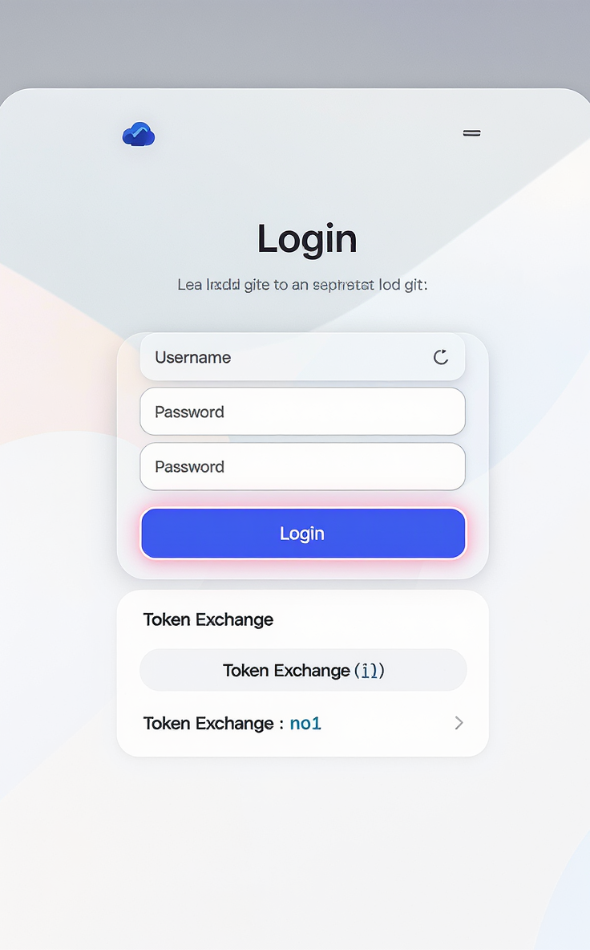
Why Use OIDC?
OIDC
OIDC is built on OAuth2, enabling secure delegated authorization and authentication for modern web and mobile apps. Supports JSON Web Tokens (JWTs) for compact, self-contained identity tokens that are easy to validate and pass between services. Enables single sign-on (SSO) across diverse SaaS applications and APIs with standardized scopes and claims. Designed for cloud-native, multi-tenant environments, making it scalable and adaptable to complex identity needs. Widely supported and expected by modern front-end frameworks, mobile apps, and APIs, ensuring interoperability and future-proofing.

Slide 7
When to Add LDAP?
LDAP
You have legacy applications that only support LDAP bind authentication or expect POSIX groups for access control. You need to support UNIX/Linux authentication via PAM or SSH against directory groups with MFA integration. Your environment requires interoperability with customer or partner Active Directory (AD) or LDAP directories without forcing modernization. You must maintain support for legacy network devices or infrastructure components that rely on LDAP for user authentication. LDAP enables bridging between traditional enterprise identity systems and modern OIDC-based services ensuring smoother migration paths.
Highlight specific legacy systems or Linux PAM/SSH use cases in your organization to justify LDAP inclusion.

Slide 8
Benefits of Adding LDAP to OIDC
Integration
Bridge Old and New Systems
Centralized Identity Management
Simplified Policy Enforcement
Operational Considerations
Adding LDAP allows legacy applications that rely on LDAP bind authentication to continue functioning seamlessly while newer applications use OIDC/OAuth2, enabling coexistence and gradual modernization.
Keycloak acts as a centralized identity provider that federates or syncs with external LDAP directories and exposes LDAP views, providing a unified identity source across modern and legacy clients.
A single policy framework in Keycloak governs both OIDC tokens and LDAP groups/attributes, reducing complexity and ensuring consistent access control across diverse authentication methods.
Implementing LDAP alongside OIDC requires synchronization mechanisms such as SCIM or LDAP sync, schema mapping for attribute consistency, and a globally replicated database to support multi-tenant scale.

Slide 9
IDaaS Reference Architecture Overview
Architecture
Keycloak is the core multi-tenant Identity Provider managing realms, users, and authentication. Cloudflare Zero Trust provides global edge security, access control, and zero-trust network access (ZTNA). YugabyteDB serves as a globally replicated SQL database for identities, sessions, and consent data. OIDC handles modern app authentication with SSO, JWT tokens, and delegated authorization. LDAP supports legacy apps and UNIX auth via Keycloak federation or LDAP storage provider.
Add specific examples of your organization's regional deployments and identity protocols to make the architecture more relatable to your engineering team.

Slide 10


IDaaS Architecture Diagram
Architecture
Use this slide to visually explain the comprehensive IDaaS architecture, emphasizing the integration of modern identity protocols and legacy directory support across global infrastructure.
Global Edge & Multi-Region Kubernetes
Core Services & Directory Integration
Cloudflare Zero Trust provides global edge security and Anycast DNS/LB routes traffic to regional Kubernetes clusters running Keycloak for tenant-scoped identity management and API gateways for ingress.
Keycloak clusters connect to a globally replicated YugabyteDB for identity data, integrate with LDAP for legacy directory support, and use SCIM for provisioning to SaaS apps, secured with HSM-backed keys and fine-grained authorization.

Slide 11
OIDC and SAML Authentication Path
Authentication
Customize this slide by adding specific examples of applications or services your team will integrate using OIDC or SAML to make it more relevant.
OIDC Authentication Flow
SAML Authentication Flow
Modern web, mobile, and SPA apps use OpenID Connect (OIDC) for single sign-on (SSO). Clients redirect users to Keycloak for authentication within tenant-specific realms. Keycloak issues JWT tokens (ID, Access, Refresh) after successful login and MFA. API gateways validate tokens before granting app access, enforcing scopes and claims. Cloudflare Zero Trust enforces access policies and device posture before allowing entry.
Legacy or enterprise applications often use SAML for federated authentication. SAML requests are routed to Keycloak through API gateways acting as service providers. Keycloak acts as Identity Provider (IdP), authenticates users and issues SAML assertions. App gateways validate SAML assertions to establish user sessions securely. Cloudflare Zero Trust integrates with SAML flows to enforce security and access policies.

Slide 12
ZTNA Access Model
ZTNA
Customize this slide by highlighting specific device posture checks your organization enforces through Cloudflare Access for enhanced security.
01
02
Cloudflare Access Role
Keycloak as Identity Provider
Enforces user identity and device posture policies before granting access. Replaces traditional VPN with identity-aware, zero-trust network access. Integrates WAF and DDoS protection at the global edge for secure access. Routes traffic through Cloudflare’s global Anycast network for performance and reliability.
Provides tenant-specific realms for multi-tenant identity management. Handles authentication with OIDC, supporting MFA and WebAuthn. Issues tokens that represent user identity and access rights. Enables seamless integration with Cloudflare Access for policy enforcement.

Slide 13
LDAP Integration in IDaaS
Integration
Legacy Apps & LDAP Bind
Keycloak’s LDAP Roles
Multi-Tenancy with LDAP Trees
Legacy applications and infrastructure use LDAP bind authentication for user access, relying on directory protocols to validate credentials and retrieve group memberships, essential for POSIX/Linux logins and traditional enterprise apps.
Keycloak acts as both an LDAP federation source, syncing identities from external LDAP or Active Directory, and as an LDAP storage provider, exposing its user and group data to legacy clients through LDAP protocol.
For multi-tenant environments, LDAP directory trees can be segmented per tenant using distinct organizational units (OUs), allowing tenant isolation and tailored access controls within a shared LDAP infrastructure.

Slide 14

SCIM Provisioning Role
Provisioning
SCIM (System for Cross-domain Identity Management) standardizes identity provisioning and updates across multiple platforms. It automates user account creation, modification, and deactivation in downstream SaaS and internal applications. SCIM ensures roles, groups, and user attributes are consistently synchronized, reducing manual errors and administrative overhead. By integrating SCIM with Keycloak, identity changes propagate seamlessly, maintaining up-to-date access controls across services. SCIM supports multi-tenant environments by handling provisioning per tenant, enabling scalable user management in IDaaS.

Slide 15
Security Components in IDaaS
Security
WebAuthn and MFA provide phishing-resistant, passwordless or multi-factor authentication to enhance user security. JWKS (JSON Web Key Sets) enable secure token signing and verification, ensuring integrity and trust in OIDC tokens. Keys for signing and encryption are securely stored and managed using Hardware Security Modules (HSM) or Key Management Services (KMS) with automated key rotation. Fine-grained authorization is enforced using Keycloak’s policy engine combined with external tools like OPA or ORY Keto for complex access control scenarios. Mutual TLS (mTLS) and internal Certificate Authorities (CAs) safeguard service-to-service communication within the IDaaS ecosystem.

Slide 16
Observability and Audit Trail
Observability
Use OpenTelemetry (OTEL) to collect telemetry data (logs, metrics, traces) from Keycloak clusters, SCIM sync service, and ZTNA components. Aggregate and store logs centrally using Loki or an EFK (Elasticsearch, Fluentd, Kibana) stack for efficient query and analysis. Integrate observability data into SIEM (Security Information and Event Management) systems for real-time alerting and incident response. Maintain detailed audit trails for OIDC authentication events, administrative actions, and Cloudflare Zero Trust access logs to ensure compliance and forensic capabilities. Leverage observability data to monitor system health, detect anomalies, and support security investigations and compliance audits.
Include specific examples of observability tools and configurations your team uses or plans to use for better contextual relevance.

Slide 17
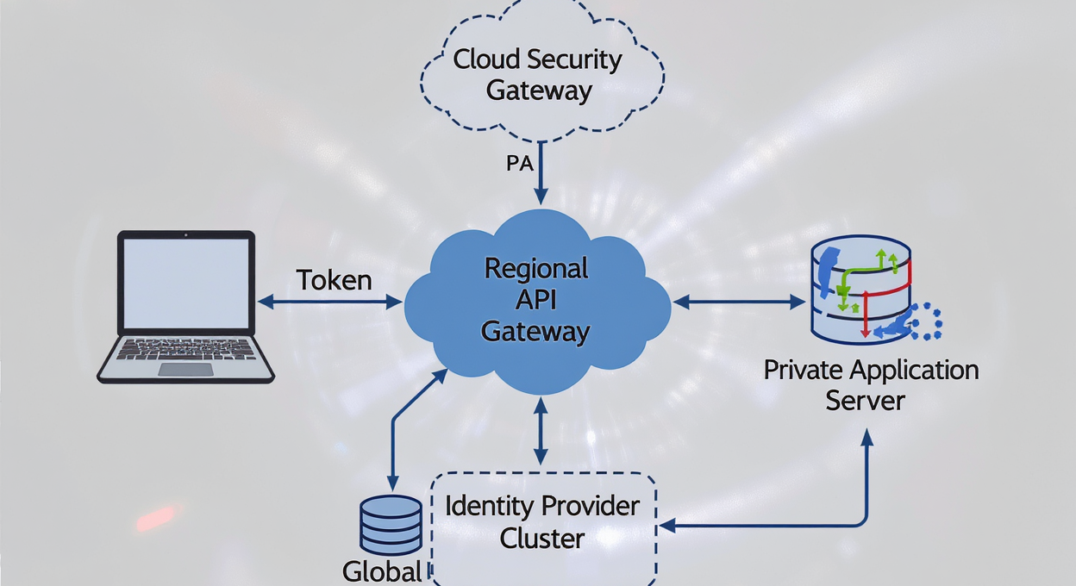

Login & Access Flow Diagram
Login Flow
Use this slide to visually explain the secure authentication and authorization flow to engineering teams for clarity on OIDC and ZTNA integration.
Login & Access Sequence
Key Components in Flow
Users request access to an app via Cloudflare Zero Trust, are redirected to Keycloak for tenant-specific OIDC authentication with MFA, receive tokens, and then access the app with identity-aware ZTNA enforcement.
Key components include the User Browser/Device, Cloudflare Zero Trust gateway, Regional API Gateway, Keycloak identity provider, YugabyteDB global database, and the Private App endpoint enforcing access policies.

Slide 18
Login & Access Flow Explained
Login Flow
Use this slide to clearly explain each phase of the login and access process, emphasizing security checks and token handling relevant to your engineering team.
01
02
03
04
05
06
User Request
Cloudflare Zero Trust Checks
OIDC Authentication Redirect
User Login and MFA
Token Issuance and Validation
Identity-Aware Access to App
The user initiates access by requesting the application URL, typically through a browser or device.
Cloudflare Zero Trust intercepts the request, enforcing WAF rules and access posture checks before forwarding to the regional API gateway.
The API gateway redirects the user to Keycloak for OIDC authentication, including tenant realm discovery to ensure proper multi-tenancy.
The user completes login by providing credentials and passing MFA/WebAuthn challenges for strong authentication.
Keycloak verifies user identity via YugabyteDB, resolves roles and consents, then issues OIDC ID, access, and refresh tokens to the user.
User presents access tokens to Cloudflare, which enforces identity and device posture policies, then connects to the private app with optional token introspection by the app.
User request logs Initial access timestamp Request metadata (IP, device)
WAF event logs Access posture evaluation reports Forwarded request to API gateway
OIDC authentication request Tenant realm identification Redirect URL to Keycloak login
Successful login events MFA challenge logs User session initialization
OIDC tokens issued User role and consent data Session state saved in global DB
Access token validation logs ZTNA connection events Authorized app content delivery

Slide 19

Practical Guidance
OIDC is the essential identity protocol for modern applications, APIs, and mobile environments.
OIDC enables seamless SSO, standardized token-based auth, and broad compatibility with cloud-native & SaaS ecosystems. It simplifies integration, boosts security with JWTs & scopes, and supports delegated authorization, making it key for any IDaaS solution.
Tailor examples to your engineering team's current app stack to highlight OIDC benefits in your environment.

Slide 20


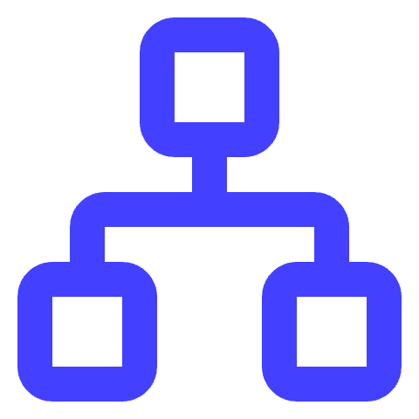
Practical Guidance: When to Add LDAP
Guidance
Customize by highlighting specific legacy apps or environments your team supports that mandate LDAP integration.
Legacy Applications
Linux PAM and SSH
Customer AD Interoperability
Include LDAP when you have legacy apps that only support LDAP bind authentication or expect POSIX group membership for access control.
Use LDAP to enable Linux PAM and SSH authentication against directory groups, supporting MFA via SSH CA or PAM modules for secure access.
Add LDAP support to federate or synchronize with external customer Active Directory/LDAP without forcing immediate modernization.

Slide 21

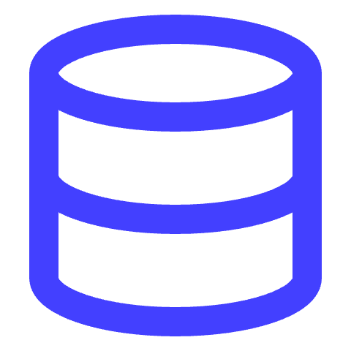
Tenant Isolation Strategy
Tenant Isolation
Customize this slide by adding examples of tenant-specific policies or schema structures relevant to your organization.
Keycloak Realms per Tenant
Per-Tenant LDAP Trees
YugabyteDB Tenant Data Partitioning
Each tenant is assigned a dedicated Keycloak realm, providing strong domain isolation, independent authentication policies, and client configurations for secure multi-tenancy.
Optionally, separate LDAP directory trees (organizational units) per tenant allow legacy systems and bind-auth clients to integrate securely without cross-tenant data exposure.
Tenant-specific data, including identities, sessions, and consents, are partitioned at the database level using tenant IDs to ensure data segregation and global consistency.

Slide 22
Keycloak Realm and LDAP Trees
Tenant Isolation
01
02
Keycloak Realms and Tenant Isolation
Tenant LDAP Trees and Synchronization
Each tenant is assigned a dedicated Keycloak realm ensuring strict data and policy isolation. Realms encapsulate tenant-specific users, clients, roles, and authentication flows. Tenant-specific OIDC/SAML clients and policies live within their respective realms. Realms act as the authoritative identity boundary for tenant operations and management.
Each tenant can have a distinct LDAP directory tree (e.g., ou=tenantX,dc=idaas,dc=local) to support legacy integrations. Keycloak uses LDAP storage providers configured as read-mostly for global consistency and conflict avoidance. Synchronization jobs keep LDAP directories updated from Keycloak realms, minimizing write contention across regions. This approach bridges modern OIDC identity with legacy LDAP clients while maintaining operational scalability.

Slide 23



Security Best Practices
Security
Customize this slide with your organization’s specific security tools and policies to make it actionable for your team.
Hardware-Backed Key Storage
JWKS Key Rotation
Enforce WebAuthn MFA
Secure Admin & Private Tools
Use KMS or HSM to securely store cryptographic keys for token signing and encryption, ensuring keys are protected from unauthorized access and easy to rotate.
Regularly rotate JSON Web Key Sets (JWKS) used for signing tokens to reduce the risk of key compromise and maintain trust across distributed systems.
Adopt WebAuthn as the default multi-factor authentication method to provide phishing-resistant strong authentication for users accessing IDaaS.
Place Cloudflare Access in front of admin consoles and private development tools to enforce identity and device posture for comprehensive access control.

Slide 24



Observability Implementation
Observability
OpenTelemetry (OTEL) Integration
OTEL collects distributed tracing, metrics, and logs from Keycloak, SCIM, and other IDaaS components to provide unified observability across the system.
Customize the observability stack details to reflect your team's existing tools and compliance requirements for the most relevant implementation guidance.
Loki/EFK Logging Stack
Logs from Keycloak, SCIM sync service, and connectors are aggregated with Loki and the EFK stack (Elasticsearch, Fluentd, Kibana) for powerful search, visualization, and alerting.
Audit Trails and Compliance
Audit logs capture OIDC authentication events, admin actions, and ZTNA access logs, ensuring traceability and compliance with security policies and regulations.

Slide 25
CI/CD and Deployment Overview
Deployment
GitLab CI automates build, test, package, and deploy stages for IDaaS components. Helm charts manage Kubernetes deployments, enabling easy configuration and upgrades. Multiple environments supported: review apps for feature branches, staging, and production. Use Docker-in-Docker (DinD) for building container images within the pipeline. Deployment targets Rancher-managed multi-region Kubernetes clusters.

Slide 26
.gitlab-ci.yml Example
CI/CD
Adapt the pipeline by adding extra testing or environment-specific deploy rules to fit your project needs.
Minimal .gitlab-ci.yml Pipeline Overview
Pipeline Stages and Jobs
Pipeline includes lint, build, package, and deploy stages for IDaaS components. Lint stage validates Helm charts to catch configuration issues early. Build stage compiles and pushes container images like the SCIM sync service. Deploy stage uses Helm to install or upgrade components in Kubernetes clusters.

Slide 27
Repository Structure for IDaaS
Implementation
Customize this slide by adding specific tooling or process notes relevant to your engineering team's existing workflows or technologies.
/infra/ Directory
/charts/ Directory
/apps/ Directory
/keycloak/ Directory
/ops/ Directory
Contains infrastructure-as-code such as Terraform scripts for cluster provisioning, DNS setup, and Cloudflare configuration to automate and manage the foundational platform components.
Holds Helm charts for deploying core IDaaS components like Keycloak, YugabyteDB, OpenLDAP/FreeIPA, SCIM sync services, observability stacks, and Cloudflare Access connectors.
Includes source code and Dockerfiles for application-level services such as the SCIM synchronization service, enabling containerized deployment and version control.
Stores JSON or ZIP Keycloak realm templates, client configurations, role definitions, and policy files to enable multi-tenant realm management and automated realm provisioning.
Contains operational assets like Cloudflare Access policy YAMLs, runbooks for SREs, threat models, audit configurations, and scripts for backup, restore, and key rotation procedures.

Slide 28
Summary: Why OIDC + LDAP?
Summary
OIDC for Modern Identity
LDAP for Legacy Support
Combined Approach Benefits
OIDC is the standard for cloud-native, web and mobile apps, enabling secure SSO, JWTs, and delegated access. It provides a scalable, multi-tenant identity layer essential for modern IDaaS implementations.
LDAP remains critical for legacy enterprise apps, POSIX/Linux authentication, and network device integrations. It bridges older systems with modern IDaaS, ensuring continuity without forcing immediate modernization.
Using OIDC alongside LDAP allows organizations to centralize identity management, maintain policy consistency, and provide seamless access across diverse app ecosystems. This hybrid model supports gradual migration and operational flexibility.
Tailor the examples in each section to reflect your organization's specific legacy systems and modern app landscape for maximum relevance.

Slide 29

Next Steps for Implementation
Implementation
Define project scope and tenant requirements to tailor IDaaS components. Set up Kubernetes clusters with Rancher for multi-region deployment. Customize and configure Helm charts for Keycloak, OpenLDAP, SCIM sync service, and YugabyteDB. Implement CI/CD pipelines with GitLab for automated linting, building, packaging, and deployment. Conduct integration testing with modern and legacy apps to verify OIDC and LDAP workflows.

Slide 30
Thank you

Slide 31
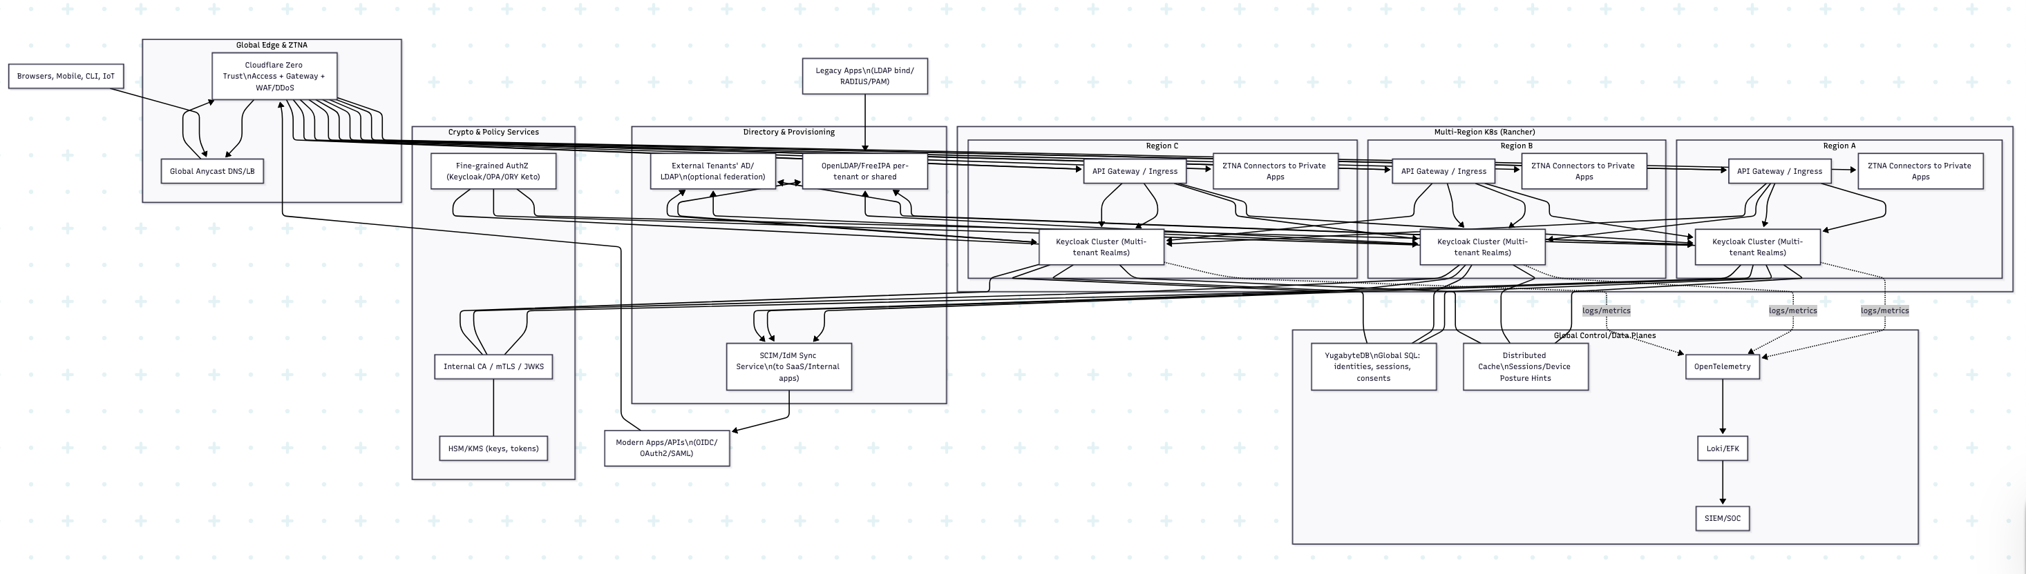
High-level components (with OIDC + LDAP

Slide 32
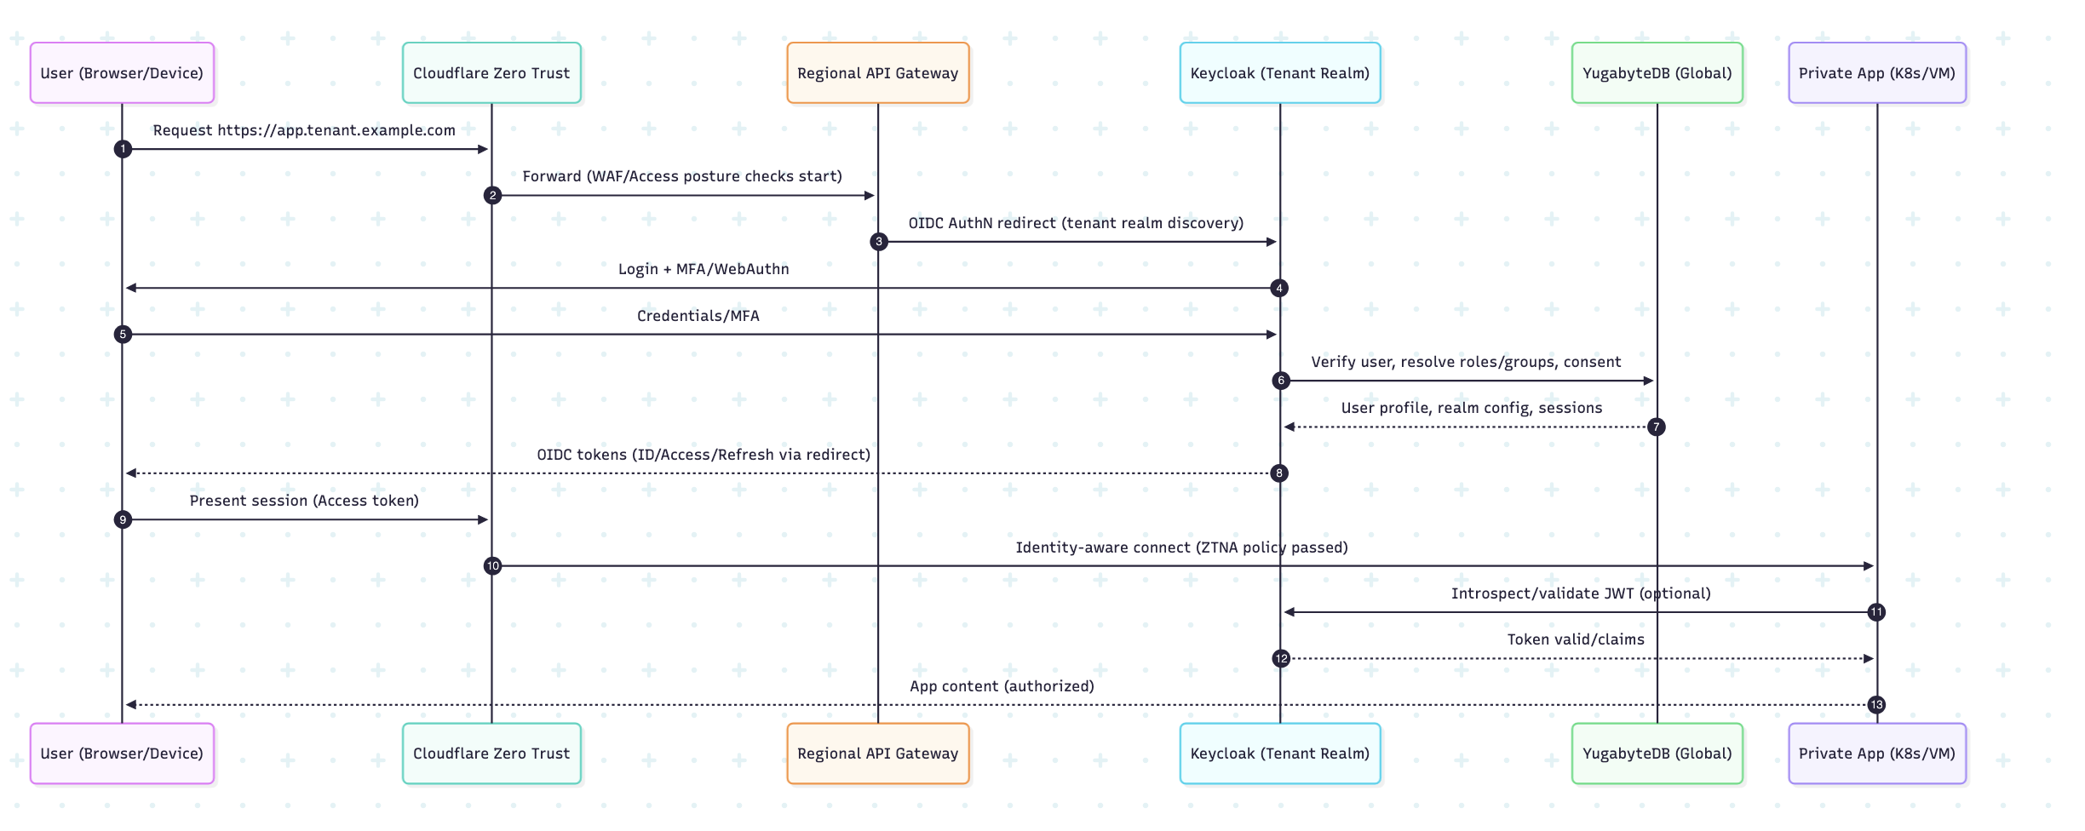
Login & Access flow (modern app via OIDC

